Slide 1
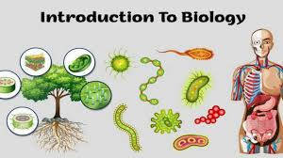
INTRODUCTION TO BIOLOGY BY TR. SSEMATIMBA GODFREY

Slide 2
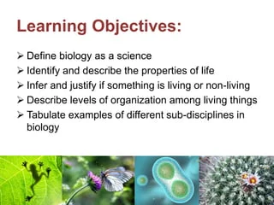
LEARNING OBJECTIVES

Slide 3
DEFINITION
Biology is the branch of science that deals with the study of living things.
OR Biology is the study of life.
Biology comes from two Greek words ‘LOGOS’ meaning study of and ‘BIOS’ meaning Life. Therefore ,Biology is the study of life.
N.B Biology is different from Primary science since it only deals with living things while science deals with the study of living things and non-living things

Slide 4
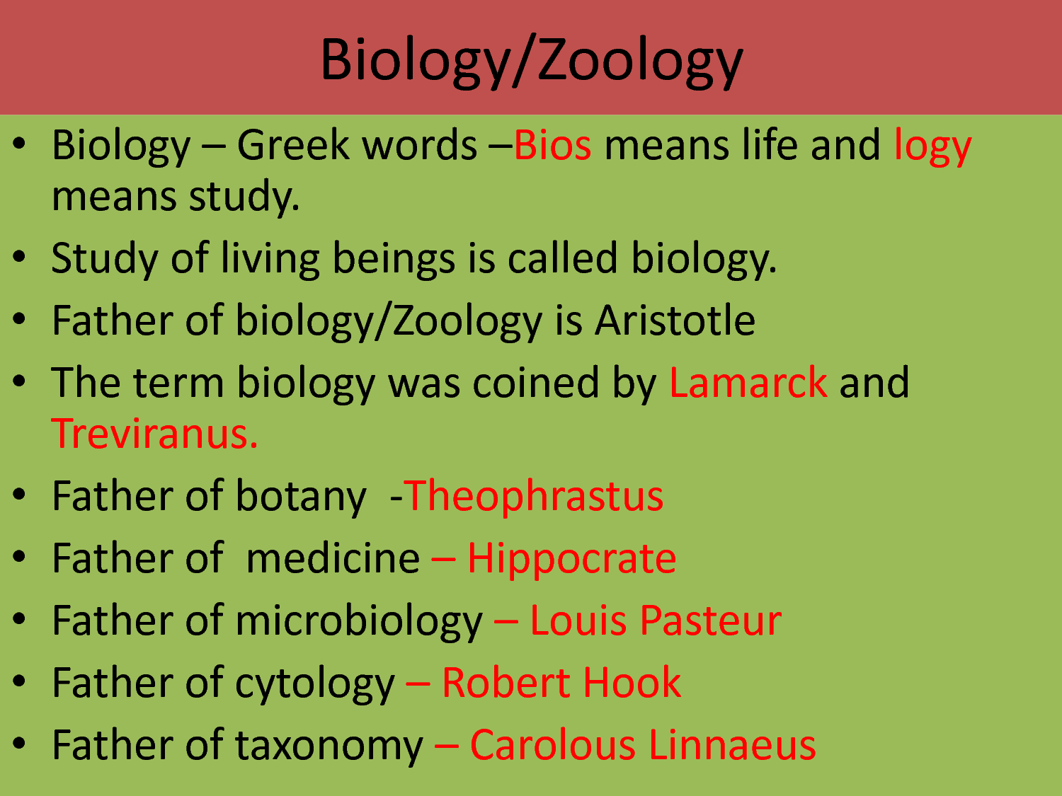

Slide 5

CAREERS AFTER STUDYING BIOLOGY
One can become a;
Teacher of biology
Zoologist
Conservation biologist
Veterinary doctor
Nutritionist
Physician
Pharmacist
Wildlife care giver etc

Slide 6

TRY THIS OUT
Write a short letter to your parents telling them how your study of biology will improve their health.

Slide 7
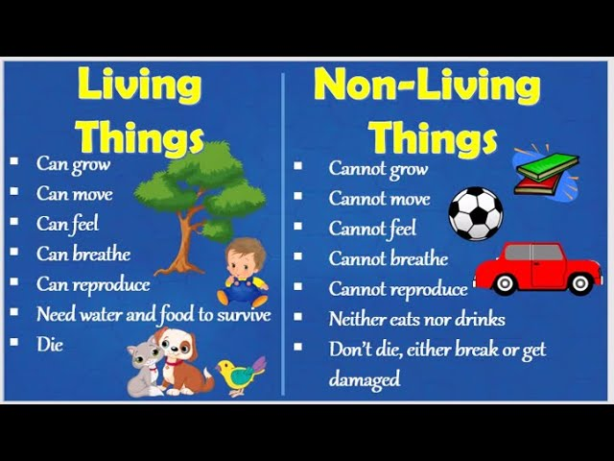
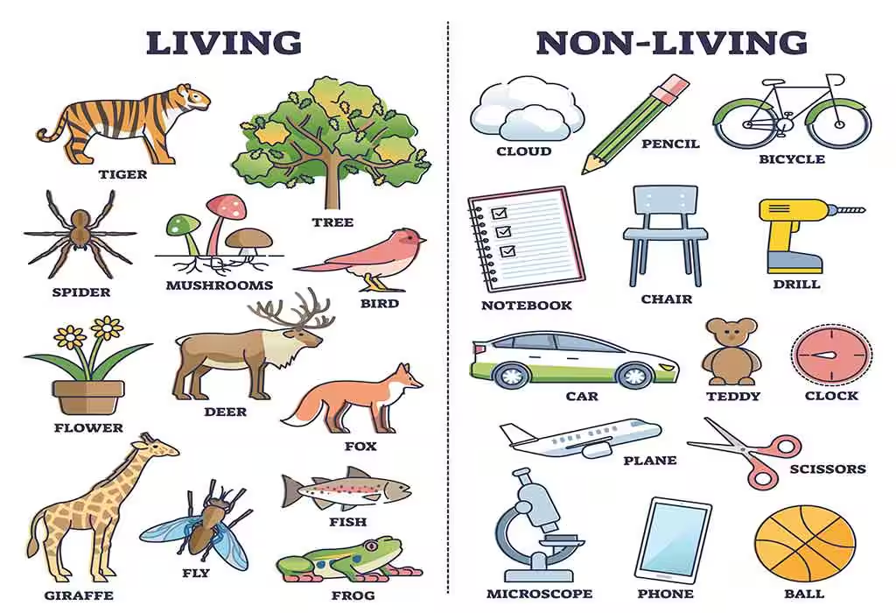
DIFFERENTIATING BETWEEN LIVING AND NON-LIVINGTHINGS
GIVE REASONS FOR COMPARISON
DISCUSS ABOUT THEM

Slide 8
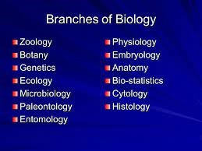
BRANCHES OF BIOLOGY
Research question;
How will specializing in the branches named help you in daily life?
In groups, identify activities that involve application of biology in daily life and present your work to the rest of the class.

Slide 9
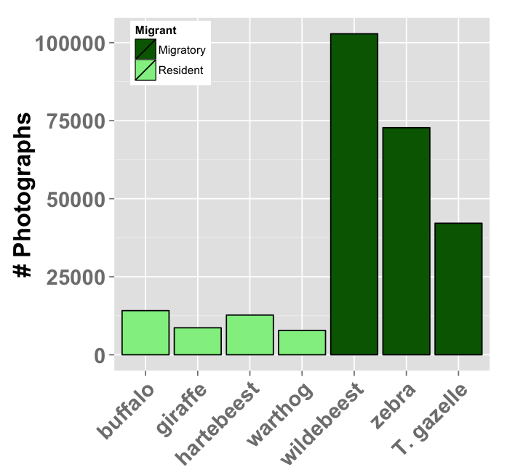
The data in the figure was collected for common organisms at UWEC . Use it to answer questions below;
Which organisms are commonest at the center?
Least commonest?
Suggest reasons for the small numbers of some organisms.
Suggest the branches of biology whose knowledge was required to obtain the data above.

Slide 10
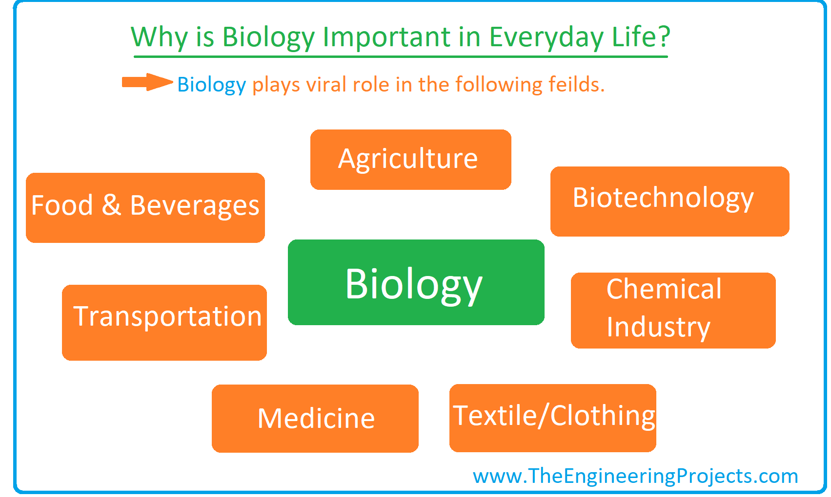
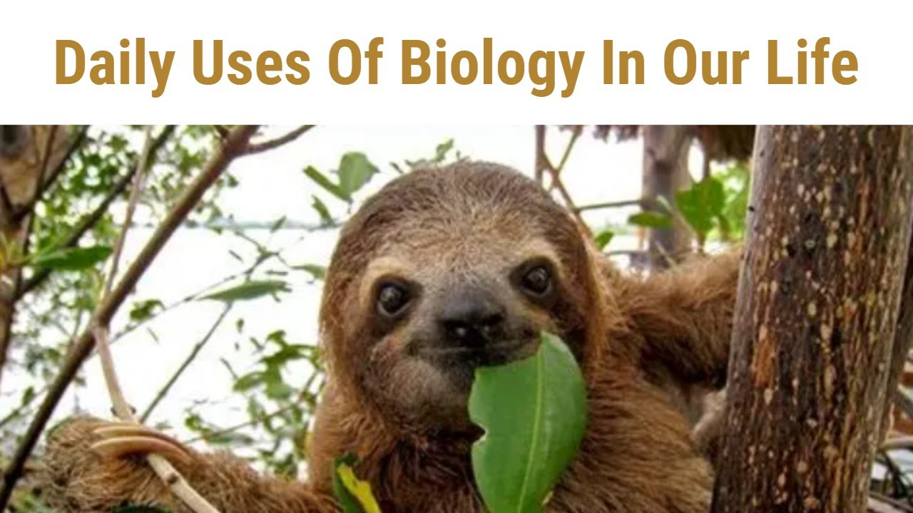
APPLICATION OF BIOLOGY IN DAILY LIFE

Slide 11
LIFE PROCESSES
All living organisms go through specific processes for their continued survival. These are known as life processes.
Life processes are key when categorizing living and non-living things. They include; nutrition,movement,sensitivity,respiration,excretion,reproduction and growth.

Slide 12
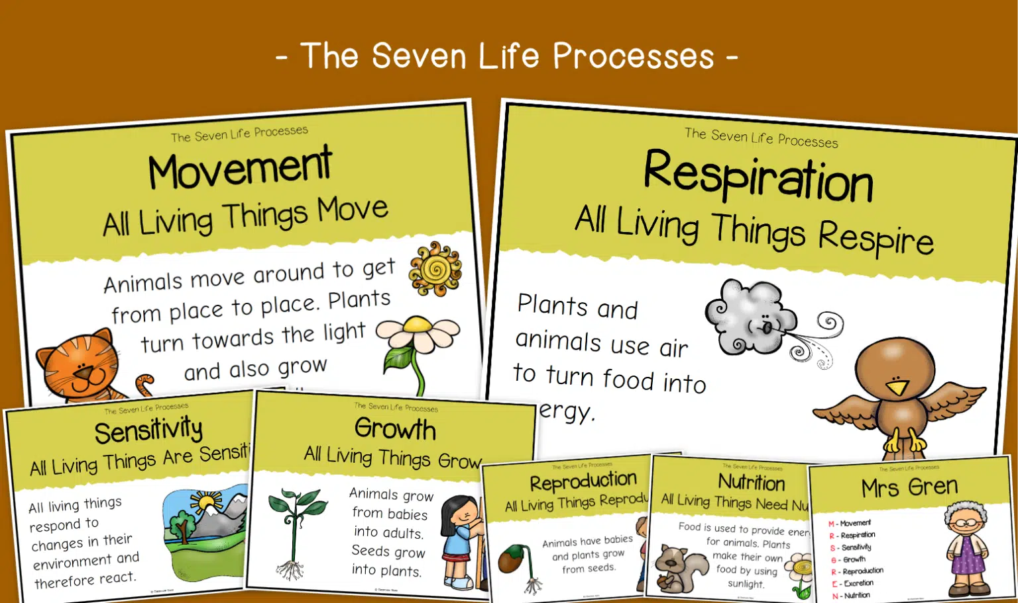
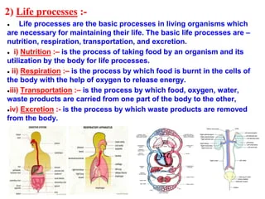
DIFFERENT LIFE PROCESSES

Slide 13
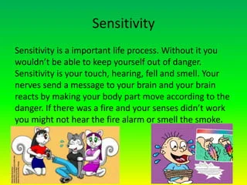
SENSITIVITY

Slide 14

NUTRITION

Slide 15
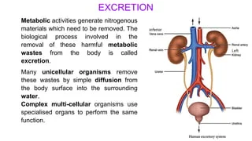
EXCRETION

Slide 16
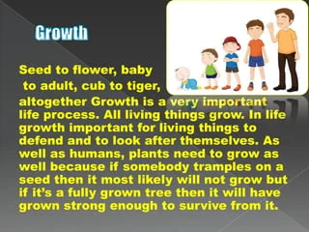
GROWTH

Slide 17
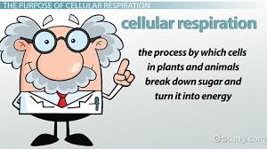
RESPIRATION

Slide 18
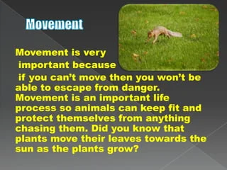
MOVEMENT

Slide 19
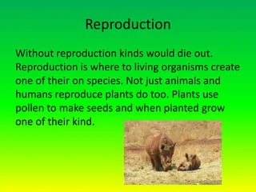
REPRODUCTION

Slide 20
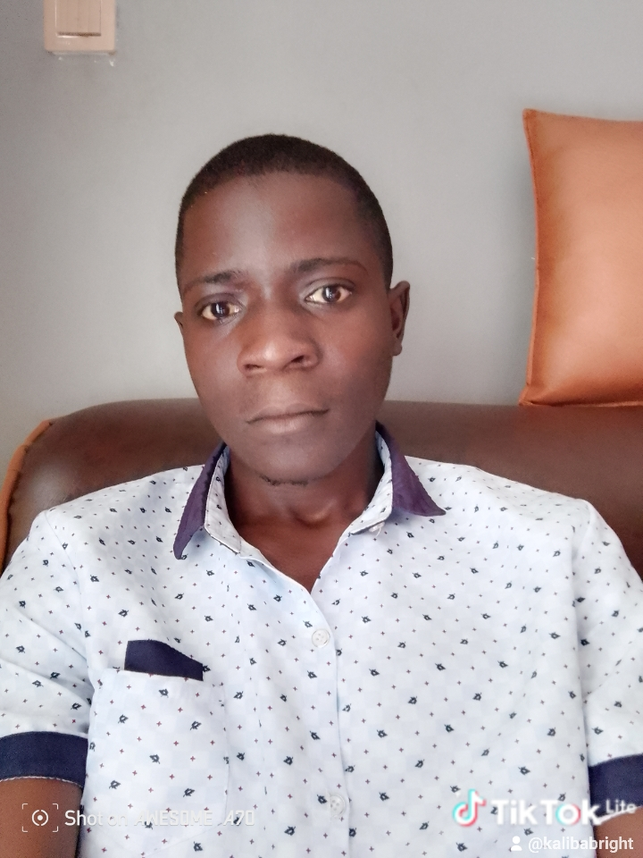
END
BY TR. SSEMATIMBA GODFREY
0756341741

